Slide 1

JAVA AGENDA FOR THE SESSION
INTRODUCTION OF JAVA
HISTORY OF JAVA
FEATURES OF JAVA
OOPS
CLASS
OBJECT

Slide 2

JAVA LEARNING ROADMAP
JAVA
JAVA
OOPS
Class
Object
Datatypes
Variables
Methods
Operators
Control flow statements
Loops

Slide 3
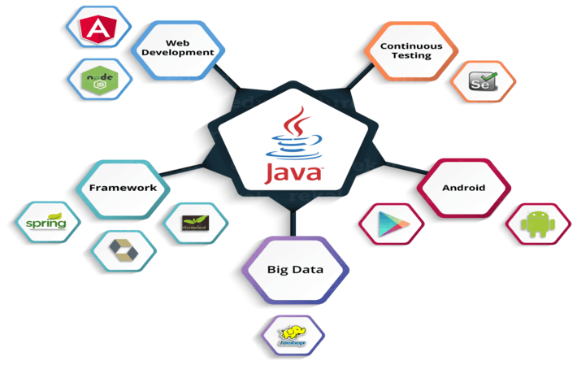
WHY JAVA

Slide 4
JAVA INTRODUCTION
Type : Open Source Software
Current Version : JavaSE17(Sep 14th 2021)
Initial Version : JDK 1.0( Jan 1996)
Creator : James Gosling & team
Initial Vendor : SUN Micro System
Current Vendor : Oracle
To download s/w : https://www.oracle.com/java/technologies/javase/jdk14-archive-downloads.html

Slide 5
HISTORY OF JAVA
James Gosling , Mike Sherida and Patrick Naughton initiated the java language project in june 1991.
The team called Green Team.
Initially designed for small , embedded systems in electronic appliances.
Firstly it was called “Greentalk” by James Gosling, and the file extension was .gt
Initially java called as “OAK”. OAK is a national tree of many countries like U.S.A , France , Germany etc.
In 1995 OAK was renamed as JAVA because oak is a trademark of OAK TECHNOLOGIES.

Slide 6
JAVA INSTALLATION
When we install java in our machine two folders are created internally. Those are
1)JDK 2)JRE
JDK is an acronym for Java Development Kit. It is used to provide development environment which is used to develop java applications and applets.JDK is an implementation of JSE,JEE,JME.
JRE is an acronym for Java Runtime Environment. It is used to provide runtime environment contains set of libraries(ex:rt.jar) plus other files that JVM uses at runtime.

Slide 7
FEATURES OF JAVA
Simple
Platform Independent
Portable
Architecture-neutral
Multi-threaded
Secured
Robust
Distributed
Object-Oriented

Slide 8
SIMPLE
Simpler than C++.
Many keywords have been eliminated.
Rich API.
No operator Overloading
No Pointers.
No Structures.

Slide 9
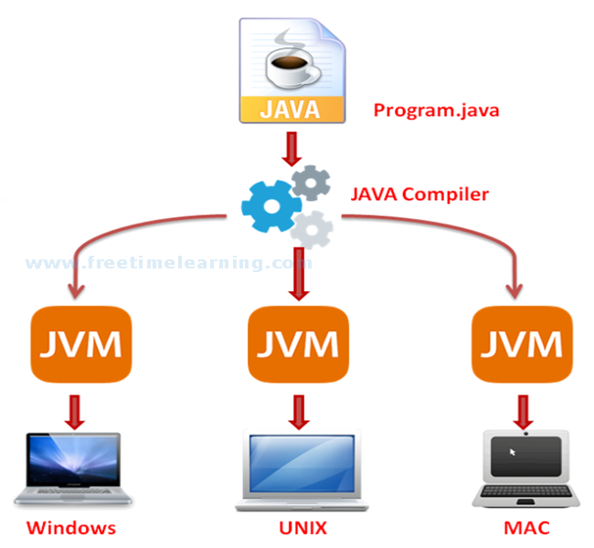
PLATFORM INDEPENDENT

Slide 10
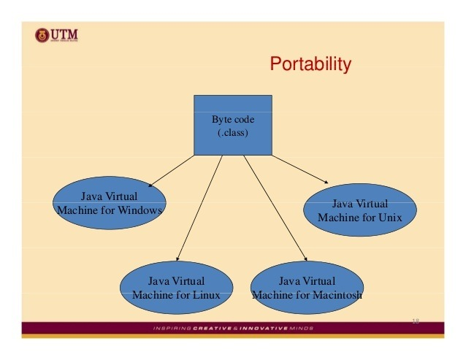
PORTABLE

Slide 11
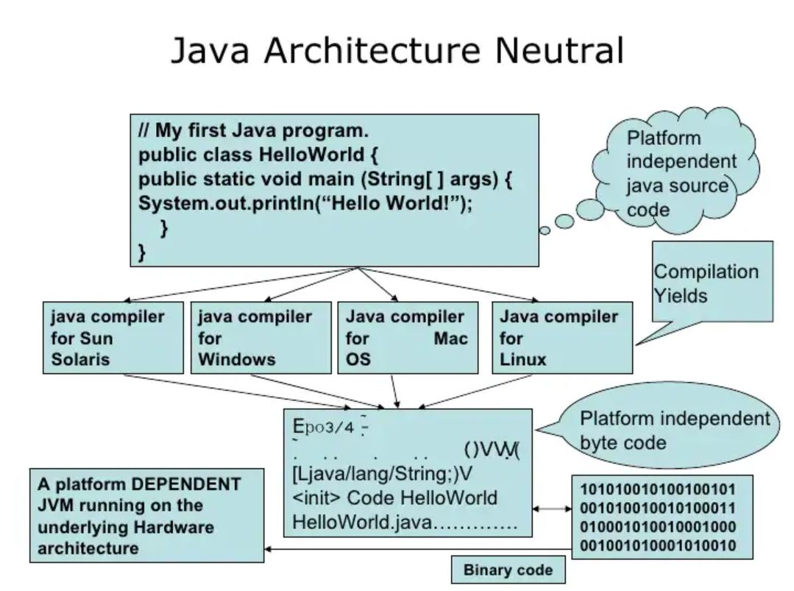
ARCHITECTURE NEUTRAL

Slide 12
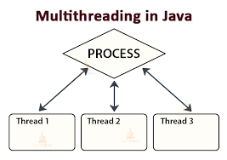
MULTITHREADED

Slide 13
SECURED
Security is everybody’s prime concern in today’s world.
Java, unlike other languages, runs all of its programs inside a sandbox of its own called the Java Virtual Machine.
So that any errors or crashes do not harm the external operating system, thus making it secure and efficient at the same time.
The ClassLoader dynamically allocates the classes defined in the program to the Java Runtime environment by separating the classes that are local to the machine and those that are imported from other network sources.

Slide 14
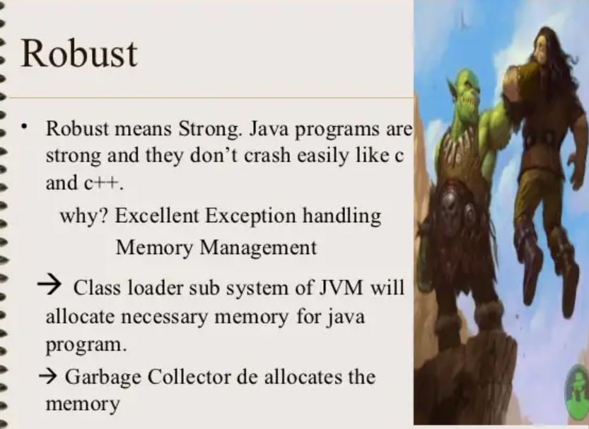
ROBUST

Slide 15
DISTRIBUTED
Java provides a set of APIs which allows user to develop distributed applications.
It means java language is used for developing distributed applications whose resources are shared by more than one client.
An application or program whose resources are shared by more than one client is called a distributed application.
As java is used for developing such applications so java is a distributed programming language.

Slide 16
OOPS
Class
Object
Inheritance
Abstraction
Encapsulation
Polymorphism
Message passing
Dynamic Binding

Slide 17
CLASS
A class is a blueprint for the object.
A class is a collection of fields and methods in a single unit is called class.
Ex: class Car
{
Int model,year;
String name;
Void start(){}
Void stop(){}
}

Slide 18
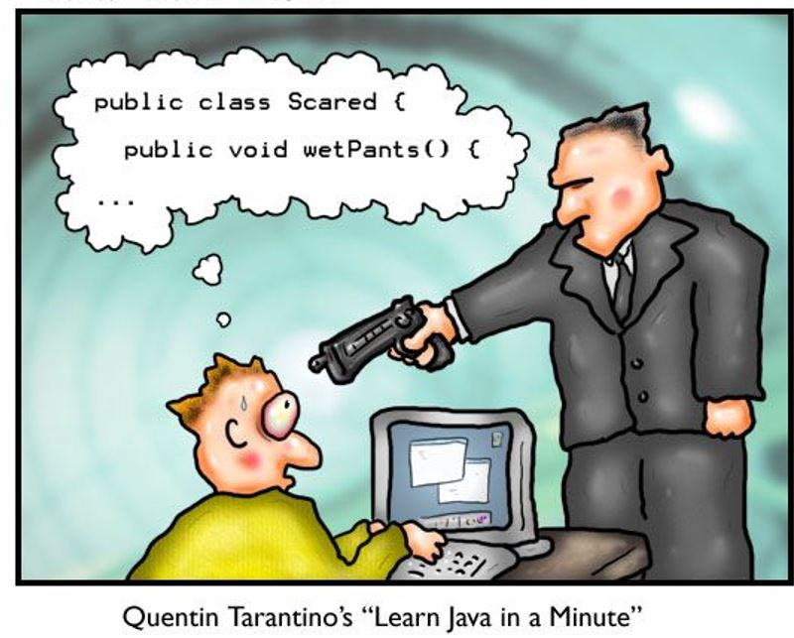
CLASS

Slide 19
OBJECT
An object is any entity that has a state and behaviour.
A class fields can represent state and methods can represent behaviour.
Creating an object in java
Car c=new Car();

Slide 20
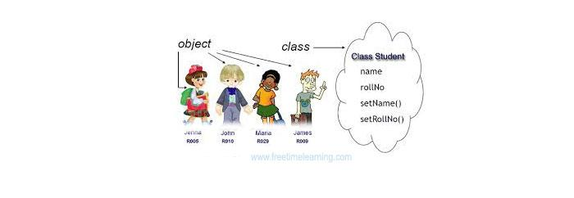
CLASS & OBJECT

Slide 21
USER INPUT
One really useful class that handles input from a user is called the Scanner class.
Scanner class is present in “java.util” package, so we import this package into our program.
To use the Scanner class, you need to reference it in your code. This is done with the keyword import. We create an object of the class to use its methods.

Slide 22
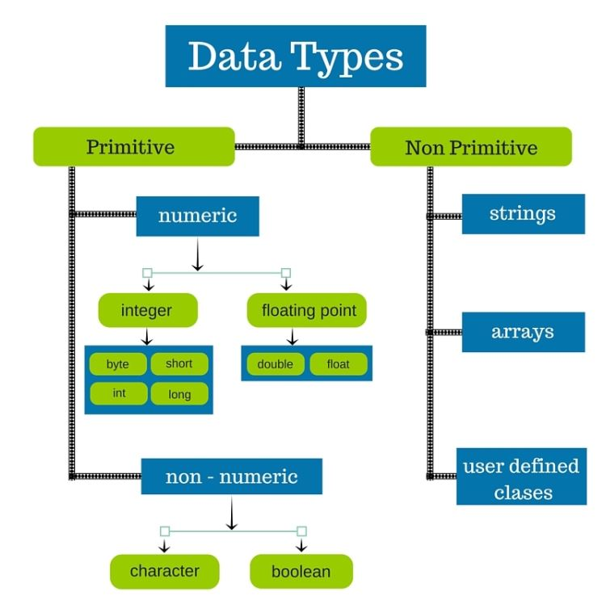
DATATYPES

Slide 23
DATATYPES
Byte : 1 byte -128 to 127
Short : 2 byte -32768 to 32767
Int : 4 byte -2,147,483,648 to 2,147,483,647
Long : 8 byte -9,223,372,036,854,775,808 to +9...807
Float : 4 byte storing 6 to 7 decimal digits
Double : 8 byte Sufficient for storing 15 decimal digits
Char : 2 byte Stores a single character/letter
Boolean : 1 bit Stores true or false values

Slide 24
VARIABLES
Variables are containers for storing data values.
Types of variables:
1)local variable
2)global variable/non-static/instance
3)static variable

Slide 25
METHODS
Method is a block of code which can be used to perform a specific action.
Types of methods:
1)non-static/instance methods
2) static methods

Slide 26
OPERATORS
An operator is a symbol that is reserved for special tasks or operations. Operators are used to performing operations on the operands.
Java supports a rich set of operators.
I) Arithmetic Operators
Ii) Relational Operators
Iii) Logical Operators
Iv) Assignment Operator.

Slide 27
CONTROL FLOW STATEMENTS
There are 3 types of control flow statements supported by the Java programming language:
a) Decision-making statements: if-then, if-then-else, switch
b) Looping statements: for, while and do-while
c) Branching statements: break, continue, return

Slide 28
LOOPS
Loop is used to execute a particular code block multiple times until a given condition holds true or until all the elements of a given JavaScript object like Array or List are completely traversed.
I) for
Ii) while
Iii) do-while

Slide 29
CONSTRUCTOR
Constructor is a special method which contains same name as class name.
No return type even void also.
Types of constructors:
1) Default or no-param constructor
2) Parameterized constructor
3) Copy Constructor

Slide 30
THIS KEYWORD
The this keyword refers to the current object in a method or constructor.
To differentiate class variables and parameters with the same name.
Function chaining.
Constructor chaining.

